Slide 1

St. Francis Institute of Technology Department of Computer Engineering
Mini Project Title: Color Detection System
Group Members:
Under the guidance of
Varsha Shrivastava
Gaurav Suvarna
Rohit Thirumump
Sakshi Tokekar

Slide 2
Content
Introduction
Problem Statement
Proposed Solution
Work Flow of the system
Algorithm with Implementation details
Experimental Set Up
Data Set
Performance Evaluation Parameters
Results & Discussion
Conclusion
References

Slide 3
Introduction
Application
Application of the system include Facial recognition, skin color recognition, object recognition, cosmetics, Color sensors are majorly used to grade colored products, distinguish coded markings, detect the presence of adhesives or data codes on a package. The technology has a wide range of applications in various industries such as textile, automation, automotive, food, printing, pharmaceutical, and many more. These sensors can also be programmed to identify any one color or multiple colors for sorting applications, based on the level of sophistication required in the color measurement process.

Slide 4
Introduction
Societal Impact
Color detection system has great societal impact as it is used in various places. It increases customer satisfaction in the cosmetic market, helps government agencies and private security as it is used in facial and object detection. It has made great progress in industrial line as it is used in the starting stepa of production, this makes the products with less defects, causing industries to losse less gains.
Research
We have tried implementing different algorithms and compared their accuracy. Random Forest algorithm was found to be the most accurate and K-Nearest Neighbor was found to be the least accurate.

Slide 5
Problem Statement
Colour detection is the process of detecting the name of any colour. Simple isn’t it? Well, for humans this is an extremely easy task but for computers, it is not straightforward. Human eyes and brains work together to translate light into colour. Light receptors that are present in our eyes transmit the signal to the brain. Our brain then recognizes the colour. Since childhood, we have mapped certain lights with their colour names. We will be using the somewhat same strategy to detect colour names. The same concept can be used to create a photo editing software, it can be also used people, who are colour blind to identify colour in an image.

Slide 6
Work Flow of the system
Main Page
Select Algorithm
Select Image
Double Click On Image for colour
Algorithm
Instructions
Press Esc to Exit

Slide 7
Algorithm with Implementation Details
K-Nearest Neighbor:
Definition: Neighbors based classification is a type of lazy learning as it does not attempt to construct a general internal model, but simply stores instances of the training data. Classification is computed from a simple majority vote of the k nearest neighbors of each point.
Logistic Regression:
Definition: Logistic regression is a machine learning algorithm for classification. In this algorithm, the probabilities describing the possible outcomes of a single trial are modelled using a logistic function.
Support Vector Classifier:
Definition: Support vector classifier is a representation of the training data as points in space separated into categories by a clear gap that is as wide as possible. New examples are then mapped into that same space and predicted to belong to a category based on which side of the gap they fall.

Slide 8
Algorithm with Implementation Details
Decision Tree:
Definition: Given a data of attributes together with its classes, a decision tree produces a sequence of rules that can be used to classify the data.
Random Forest:
Definition: Random forest classifier is a meta-estimator that fits a number of decision trees on various sub-samples of datasets and uses average to improve the predictive accuracy of the model and controls over-fitting. The sub-sample size is always the same as the original input sample size but the samples are drawn with replacement.

Slide 9
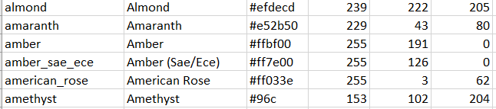
Experimental Setup
Dataset used : colors.csv (CLICK ON colors.csv TO OPEN DATSET)
Data Sample :
COLOR_NAME COLOR HEX R G B
Input: R, G, B values of the point that is double clicked
Output: Color

Slide 10
Experimental Setup
ALGORITHM | ACCURACY
K-Nearest Neighbour | 16.18%
Logistic Regression | 44.51%
Decision Tree | 84.97%
Support Vector Classifier | 86.13%
Random Forest | 89.02%
Accuracy: Machine learning model accuracy is the measurement used to determine which model is best at identifying relationships and patterns between variables in a dataset based on the input, or training, data.
Ideal Case: The ideal case will be when the correct is detected perfectly
Worst Case: The worst case will be when the process is very slow and output is incorrect
Best : It is observed that Random Forest gives the best result with accuracy 89.02%
Worst : It is observed that K-Nearest Neighbor has the lowest accuracy percentage → 16.18%

Slide 11
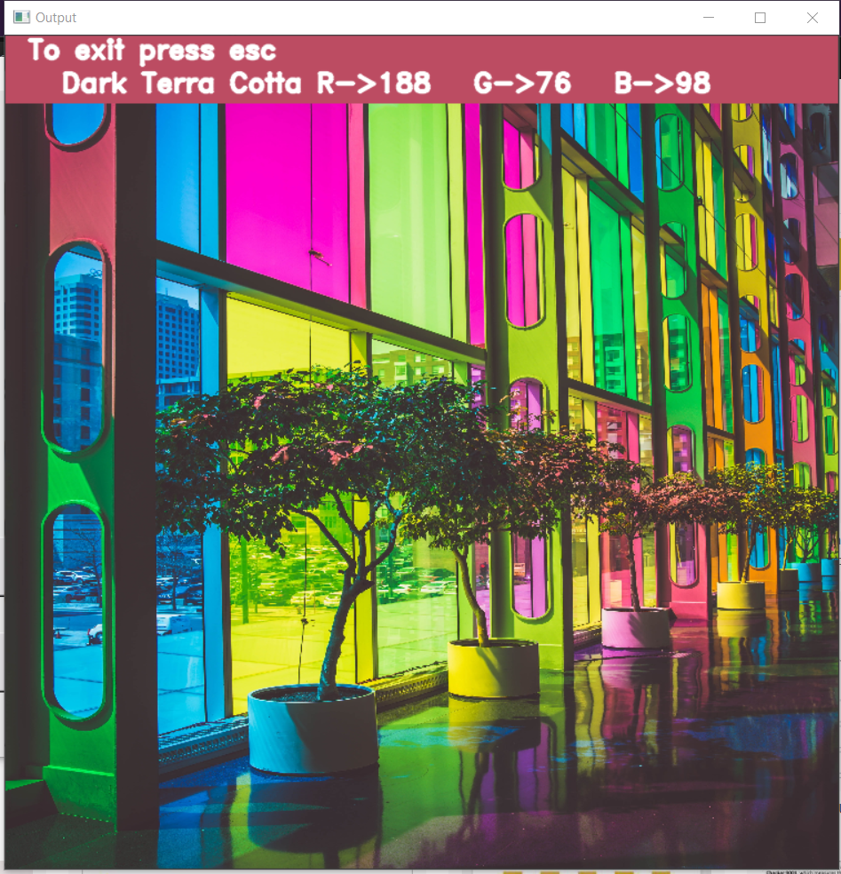
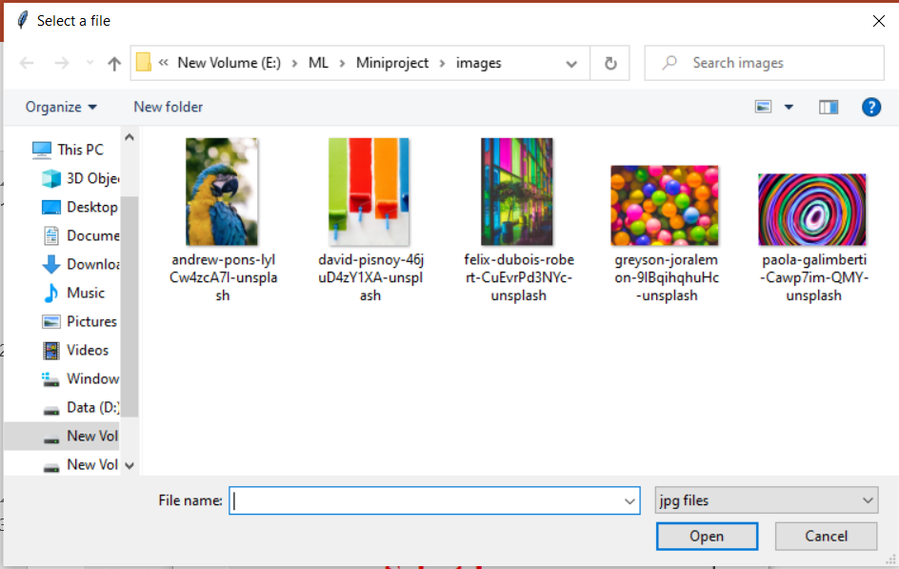
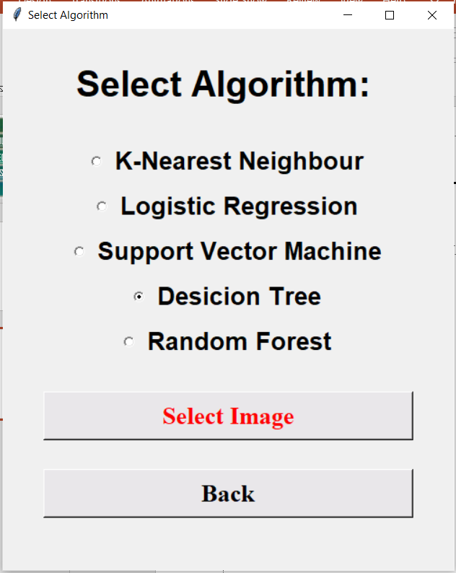
Results and Discussions
Double Click on a point to know the colour
Press Esc to exit
SELECT IMAGE
SELECT ALGORITHM

Slide 12
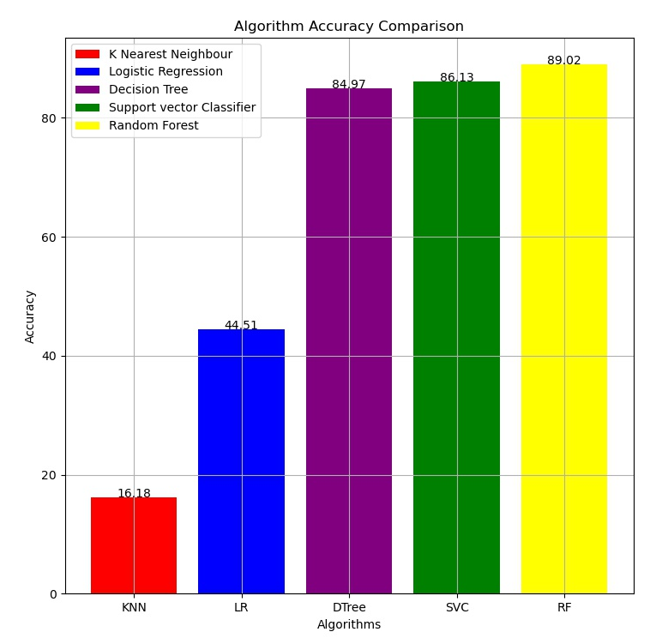
Algorithm Accuracy Comparison

Slide 13
Conclusion
While developing this project we learned a lot, from image processing to training the model and calculating the accuracy.
This project taught us how to use different model and implement it to image.
As the Bar above shows, Random Forest Classification has the highest accuracy for predicting the color from an image.
While K-Nearest Neighbor has the worst accuracy of predicting the color from an image.

Slide 14
References
[1] Petrie KJ, Mueller JT, Schirmbeck F, Donkin L, Broadbent E, Ellis CJ et al. “Effect of providing information about normal test results on patients’ reassurance: randomised controlled trial”. British Medical Journal [Online] 2007;334(7589): 352-354. Available from: doi: 10.1136/bmj.39093.464190.55 [Accessed 26th August 2011].
[2] Treloar, D 1999, “Grains of sense”, Australian Gourmet Traveller, November, pp. 29-30, 64.
[3] https://www.ijcaonline.org/archives/volume161/number8/goel-2017-ijca-913254.pdf
[4] https://www.irjet.net/archives/V3/i10/IRJET-V3I10222.pdf
[5] https://ieeexplore.ieee.org/document/5946088
[6] https://ieeexplore.ieee.org/document/6248068
[7] https://ieeexplore.ieee.org/document/6466131

Slide 15
Thank you !!!
Q & A ??

